Slide 1
Ceramics
Dr. Ranjit Kumar
Department of Chemical Engineering
Email: ranjit.kumar@snu.edu.in

Slide 2
Taxonomy of Ceramics
Glasses
Clay
Refractories
Abrasives
Cements
Advanced
products
ceramics
-optical
-whiteware
-bricks for
-sandpaper
-composites
engine
-
composite
-
bricks
high T
-
cutting
-
structural
-
rotors
reinforce
(furnaces)
-
polishing
-
valves
-
containers/
-
bearings
household
• Properties:
-- Tm for glass is moderate, but large for other ceramics.
-- Small toughness, ductility; large moduli & creep resist.
• Applications:
-- High T, wear resistant, novel uses from charge neutrality.
• Fabrication
-- some glasses can be easily formed
-- other ceramics can not be formed or cast.
-sensors

Slide 3
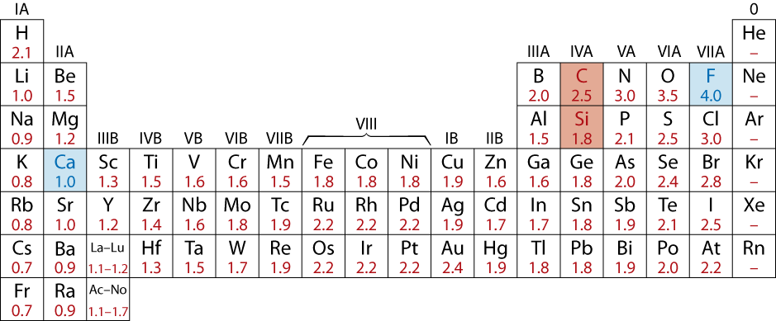
Ceramic Bonding
• Bonding:
-- Mostly ionic, some covalent.
-- % ionic character increases with difference in
electronegativity (remember!?!).
• Large vs small ionic bond character:
CaF₂: large
SiC: small

Slide 4
Ceramic Crystal Structures
Oxide structures
oxygen anions much larger than metal cations
close packed oxygen in a lattice (usually FCC)
cations in the holes of the oxygen lattice
The same ideas apply to all “ceramics”
Principles of Ceramic Architecture:
Size relationships Cation to Anion
Electrical Neutrality of the overall structure
Crystallographic Arrangements
Stoichiometry Must Match

Slide 5






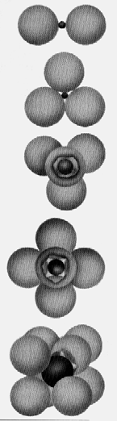


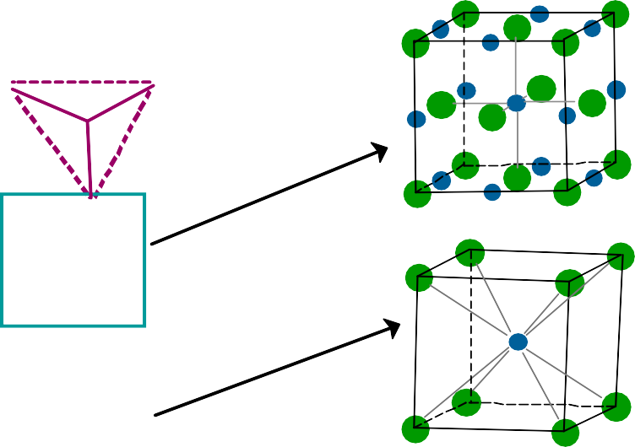
COORDINATION # AND IONIC RADII
^{r}cation ^{r}anion
Coordination # increases with
Issue: How many anions can you arrange around a cation?
^{r}cation ^{r}anion
ZnS (zincblende)
Coord #
< .155
2
.155-.225 3
NaCl (sodium chloride)
.225-.414 4
.414-.732 6
CsCl (cesium chloride)
.732-1.0 8

Slide 7
Summary of Some Common Ceramic Crystal Structures

Slide 8
Ionic Radii for Several Cations and Anions for a Coordination Number of 6

Slide 9
Q. On the basis of ionic radii, what crystal structure do you predict for FeO?
Solution
First, note that FeO is an AX-type compound. Next, determine the cation–anion radius ratio,
This value lies between 0.414 and 0.732, and, therefore, the coordination number for the Fe²⁺ ion is 6; this is also the coordination number of O²⁻ because there are equal numbers of cations and anions. The predicted crystal structure is rock salt, which is the AX crystal structure having a coordination number of 6.

Slide 10
Practice Question
Q. the ionic radii for K⁺ and O²⁻ as 0.138 and 0.140 nm, respectively.
(a) What is the coordination number for each O²⁻ ion?
(b) Briefly describe the resulting crystal structure for K₂O.
(c) Explain why this is called the antifluorite structure.

Slide 11
Ceramic Density Computations
It is possible to compute the theoretical density of a crystalline ceramic material from unit cell data in a manner similar to metals. In this case the density 𝜌 may be determined using a modified form of Equation for metals, as follows:
where
nʹ = the number of formula units within the unit cell1
ΣA_{C} = the sum of the atomic weights of all cations in the formula unit
ΣA_{A} = the sum of the atomic weights of all anions in the formula unit
V_{C} = the unit cell volume
N_{A} = Avogadro’s number, 6.022 × 10²³ formula units/mol

